Slide 1
More
Vector
Basics

Slide 2
Reviewing Yesterday’s Material + A Few Things
Today we will review what we did yesterday, as well as applying those concepts to the linear combination form.
We will also add the concept of direction angles for vectors and the trigonometric form of vectors.

Slide 3
Scalars with Linear Combinations
Example: Given u = 3i + 5j, find 4u.
“distribute”
4u
= 4(3i + 5j)
= 4(3i) + 4(5j)
= 12i + 20j

Slide 4
Adding Vectors – Geometrically
“Parallelogram Method”
Given two vectors, to add them geometrically, you can use a parallelogram.
First, join the vectors initial points (tails).
Second, create two more vectors that are equal to the original vectors. Place them where the tails meet the heads of the first set and join their heads to make a parallelogram.
Finally, the resultant vector of this addition is the diagonal from the joined tails to the joined heads.

Slide 5
Adding Vectors in Written Form
Examples. Given u = 3i + 5j and v = 2i – 4j find the following vectors.
2u - v =
2(3i+5j) – (2i-4j)
= (6i+10j) + (-2i+4j)
= 4i+14j

Slide 6
Unit Vectors
A unit vector is a vector of magnitude 1 (in any direction).
To find a unit vector in a specific direction (the direction of another given vector), you must “divide” the given vector using scalar multiplication so that the new vector’s magnitude is 1.
Find the magnitude of the given directional vector.
Multiply by the reciprocal of the magnitude.

Slide 7
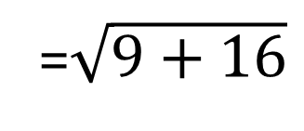
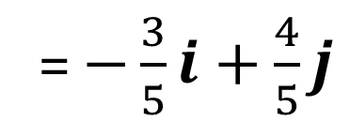
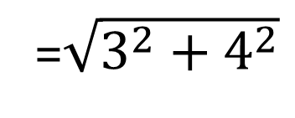
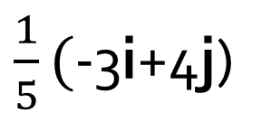
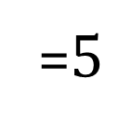
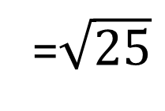
Unit Vectors
Example: Find the unit vector in the same direction as -3i+4j.
1. Find the magnitude of -3i+4j
||-3i+4j||
=$\sqrt{3^{2}+4^{2}}$
=$\sqrt{9+16}$
=$\sqrt{25}$
=$5$
2. Find the unit vector by multiplying by the reciprocal.
$\frac{1}{5}($-3i+4j)
= $−\frac{3}{5}i+$ $\frac{4}{5}j$

Slide 8
Finding a NEW Vector in the Same Direction
If you need a vector of a different magnitude in the same direction as a given
Find the unit vector in the same direction.
Multiply by the new magnitude.

Slide 9
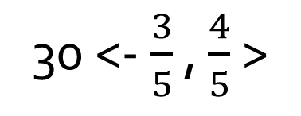
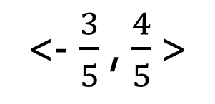
Unit Vectors
Example: Find the vector of magnitude 30 in the same direction as <-3, 4>.
1. Find the Unit Vector.
<-$\frac{3}{5}$ , $\frac{4}{5}$ >
2. Multiply by the needed magnitude.
30 <-$\frac{3}{5}$ , $\frac{4}{5}$ >
= <-$\frac{3(30)}{5}$ , $\frac{4(30)}{5}$ >
= <-$18$ , $24$ >

Slide 10
Direction Angles of Vectors
The direction angle of a vector is the (standard) angle of the vector when it is in standard position.
Using it’s horizontal (x) and vertical (y) components, we can find the direction angle, Ѳ, of a vector using:
$$tanθ= \frac{y}{x}$$

Slide 11
Trigonometric Form of Vectors
Considering that the horizontal component of any right triangle is related to the cosine and the vertical component is related to the sine, we can put any vector into it’s Trigonometric (component) Form based on its magnitude and direction angle.
The Trigonometric Form of a vector
Given a vector, v = <x, y> with direction angle $θ$, the trigonometric form of v is
v = <||v||cos $θ$, ||v||sin $θ$>

Slide 12
Direction Angles and Trig Form of Vectors
Example: Given w = <5, -8>,
Find the direction angle of w
Put w in trigonometric form

Slide 13
Using Direction Angles and Trig Form
Example: Find the component form of a vector with magnitude 18 and direction angle 150º.

Slide 14
Using Direction Angles and Trig Form
Example
(a) Find the resultant of adding a vector with magnitude 10 and direction angle 30º with a vector of magnitude 4 with a direction angle of 80º.
(b) Find the direction angle for the resultant.

Slide 15
Assignment
Assignment 3
Alternate Text – On Blog
p. 434 #29, 30, 41-44, 51, 53, 61-73

