Slide 1
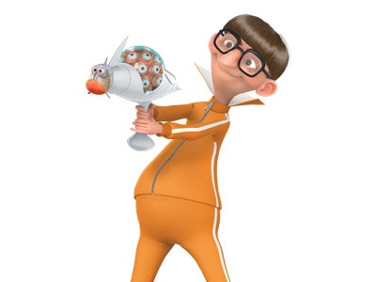
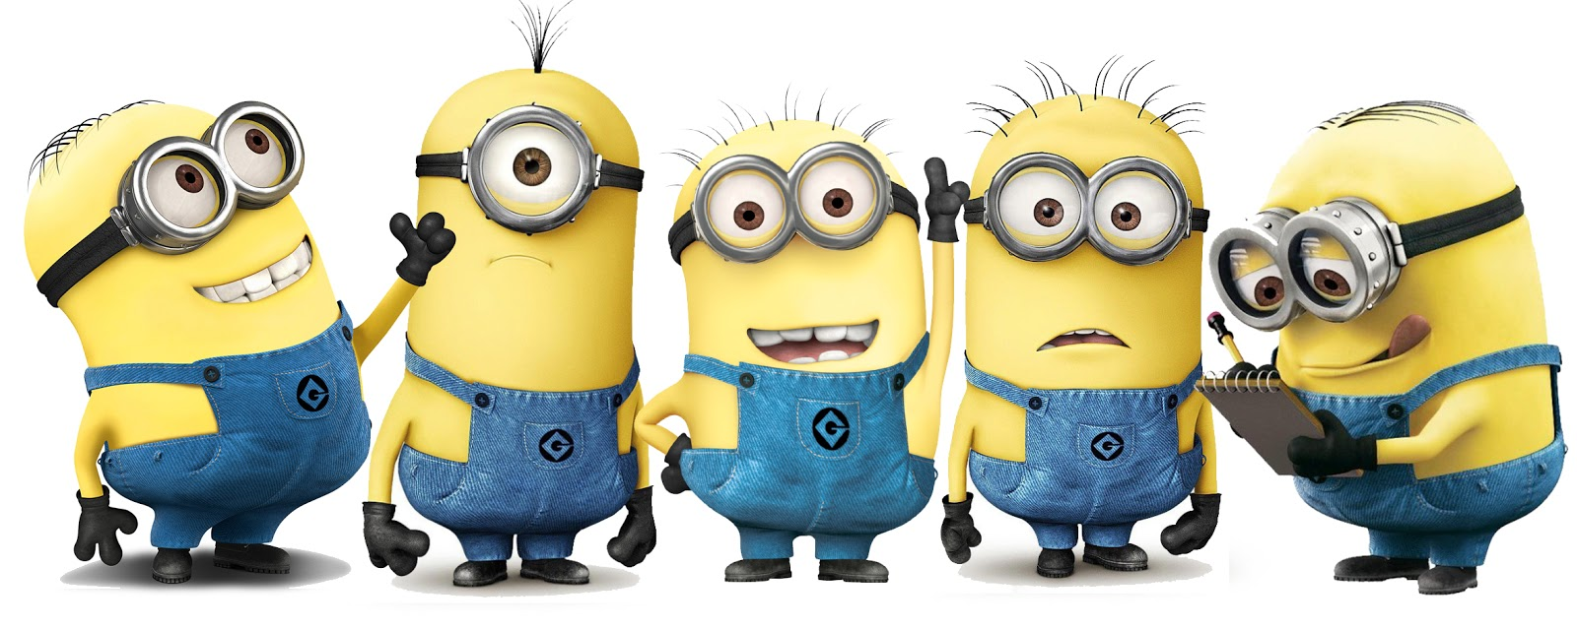
VECTORS

Slide 2
Vectors
There are two types of quantities in the world.
Scalar – a quantity that is specified by a single value with an appropriate unit and has no direction. (Examples: temperature, height, length of string)
Vector – a quantity that has both magnitude (size) and direction.
(Examples: driving west at 50 mph, pulling a cart up a hill, weight)

Slide 3
Vectors
Vectors have non-negative magnitude (size) and a specific direction.
To represent them, we use directed line segments.
The segments have an initial point and a terminal point.
At the terminal point, we represent the direction of the vector with an “arrow head.”
Q
Example: The vector from P to Q.
P

Slide 4
Notations
Notations for Vectors
using points: (use a half arrow over the points in order)
using vector name (typed): v (bold lowercase letter)
using vector name (handwritten): (lowercase letter with half arrow)
Notation for Magnitude

Slide 5
Vectors
Vectors are said to be in “Standard Position” if its initial point is (re-)located at the origin.
Most vectors can be thought of as position vectors because any vector can be re-positioned at the origin.
By initiating a vector at the origin, we can easily manipulate the horizontal and vertical components of the vector.

Slide 6
Component Form
The component form of a vector is written as the “end point” when the vector is in standard position (initial point at the origin).
The component form of the vector from P(a, b) to Q(c, d) can be found by subtracting the components of each point.
<c-a, d-b>
This is also called the position vector.

Slide 7
Linear Combinations
The linear combination form of a vector uses scalars of the standard unit vectors i = <1, 0> and j = <0, 1> to write the position vector.
For example, the vector <3, 5> can be written in the form
3i + 5j
Because 3i + 5j = 3<1, 0> + 5<0, 1> = <3, 0> + <0, 5> = <3, 5>

Slide 8
Forms of Vectors
Write the vector from P to Q in both its component form and as a linear combination of i and j.
P = (3, 8)
Q = (-4, 18)
In general, in what direction does this vector head?

Slide 9
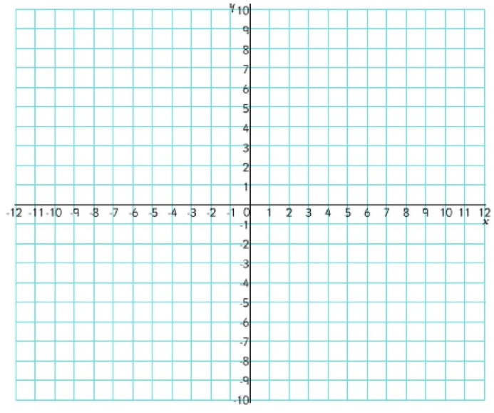
Forms of Vectors
Find the magnitude and describe the actual direction of the vector from P to Q.
P = (3, -4), Q = (-2, 4)
||PQ|| = $\sqrt{\text{(5)}\text{2}\text{ + (8)}\text{2}}$ = $\sqrt{89}$
Q
Up 8 or +8
Direction: Left 5 and Up 8
or
Up & Left with a slope of -8/5
P
Left 5 or -5

Slide 10
Equal Vectors
Vectors are equal if they have the same magnitude AND direction.
Location does not matter when determining if vectors are equal.
To show that two vectors are equal, show that their magnitude is the same and that they travel in exactly the same direction.

Slide 11
Equal Vectors
Determine if each of the following pairs of vectors are equal. If not, state why not.
Initial Point Terminal Point
A(2, 2) B(5, 7)
R(4, 3) S(7, 8)
A(3, 1) B(-2, -7)
R(1, -4) S(6, 4)

